Slide 1
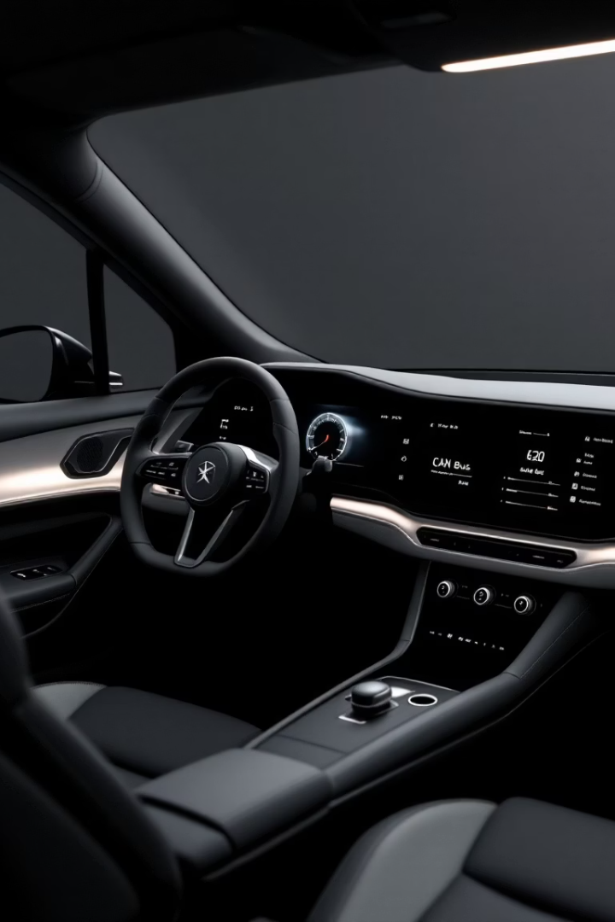

Introduction to CAN Bus and Automotive Cybersecurity
Controller Area Network (CAN) is the leading automotive communication network. It lacks inherent security, exposing vehicles to cyber risks. Attacks like the Jeep Cherokee hack (2015) highlight vulnerabilities and rising threats in automotive cybersecurity.

Slide 2
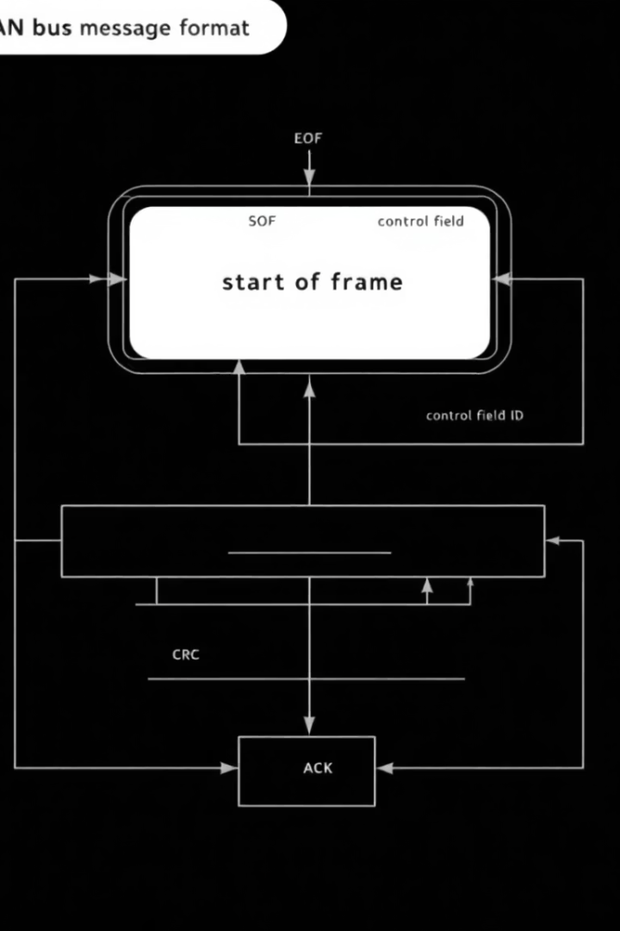
CAN Bus Data and Cybersecurity Threats
Attack Vectors
Spoofing, replay attacks, and denial of service target CAN bus communications.
Anomaly Types
Frequency irregularities, data range errors, and sequence disruptions.
Regulations
UNECE WP.29 and ISO/SAE 21434 set automotive cybersecurity standards.
Risks
Compromised vehicle control, safety system failures, and data breaches.

Slide 3
ML-Based Anomaly Detection Methodology
Data & Features
Algorithms
Evaluation
Collect CAN logs. Engineer features like frequency, entropy, and ID patterns.
Variational Autoencoders for unsupervised detection
Use precision, recall, F1-score, and ROC AUC metrics for validation.
Isolation Forests to isolate outliers
One-Class SVM to model normal behavior

Slide 4
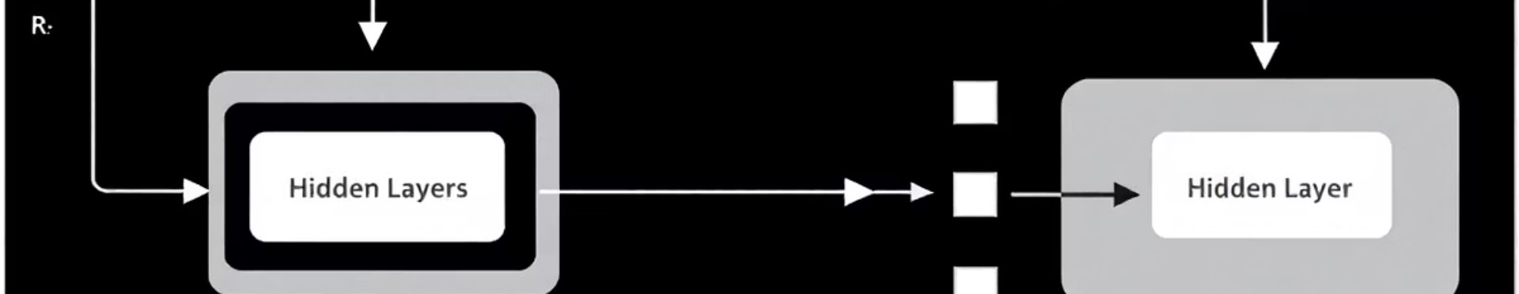
Autoencoder Implementation
1
Architecture
2
Function
3
Anomaly Detection
Multilayer perceptron autoencoder with input, hidden, and output layers.
Reduce dimensionality to capture normal behavior, reconstruct input features.
Calculate reconstruction error and use threshold based on statistical analysis.

Slide 5
Real-Time Implementation and System Architecture
Edge Computing
Optimization
Response Actions
Embedded systems process CAN messages with low latency under 1ms.
Techniques include quantization, pruning, knowledge distillation.
Trigger alerts, gateway shutdown, or failsafe mode upon detection.
Frameworks used: TensorFlow Lite, ONNX Runtime.

Slide 6
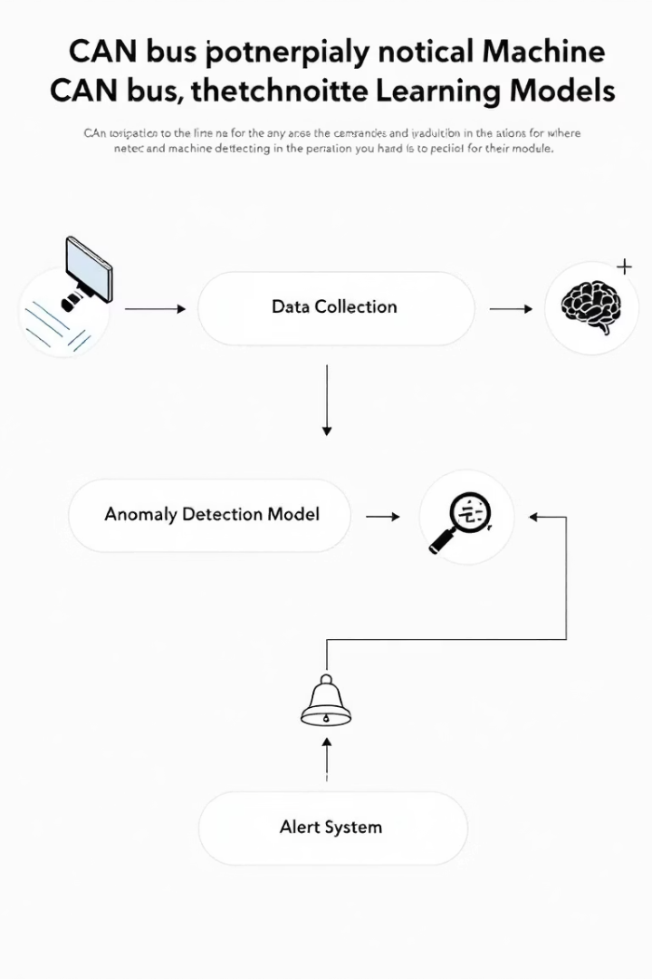
Performance Metrics and Validation
Model
Detection Accuracy
False Positive Rate
ROC AUC
Autoencoder
98%
1%
0.99
Isolation Forest
95%
2%
0.97
One-Class SVM
92%
3%
0.95
Machine learning models outperform traditional rules with improved adaptability and robustness.

Slide 7
Challenges and Future Directions
Data Drift
Adapt models to evolving CAN traffic patterns over time.
Adversarial Attacks
Improve robustness to evade detection by sophisticated threats.
Explainable AI
Enhance interpretability of detection results for trust and action.
Federated Learning
Collaborative training across vehicles preserving data privacy.
Transfer Learning
Apply models from one vehicle type to others efficiently.

Slide 8

Conclusion
ML Detection Promises
Edge Deployment
Enables real-time protection for connected vehicles.
Optimized models support low latency and resource constraints.
Future Scope
Applications
Addressing challenges will improve vehicle safety and privacy.
Intrusion detection, secure gateways, and autonomous driving security.

